Slide 1
Airline Passenger Satisfaction
Marios Almpanopoulos, Petros Batakis, Petros Malamas

Slide 2
Motivation and Benefits
We are in peak travel season
Increasing Competition in the industry
Enhance customer experience
Increase customer loyalty
Optimized resource allocation

Slide 3
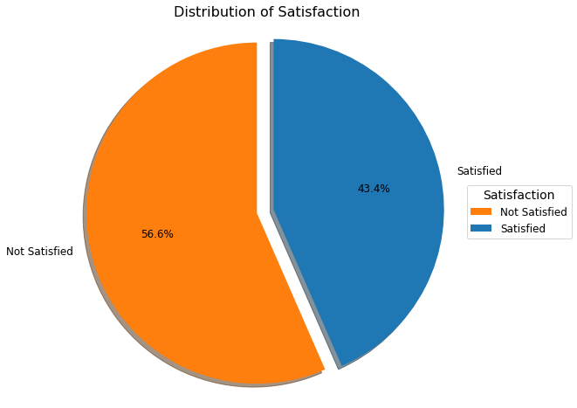
Satisfaction levels low
The Problem
56.6% not satisfied with service provided
Room for improvement
Satisfaction derived from previous experience:
major factor when selecting airline
Identify areas for improvement
Proactive measures
Data-driven decisions
GOALS
Enhance customer experience
Improve satisfaction metrics
Overall business performance
Dataset Overview
OUTCOMES

Slide 4
Understanding the Dataset
FLIGHT
Flight Distance
Departure/Arrival time convenient
Arrival/Departure delay
SERVICES
Inflight Wifi
Food and Drink
Class
Seat comfort
Inflight service
Inflight entertainment
On-board service
Leg room service
Cleanliness
Baggage handling
PASSENGER
Gender
Customer Type
Age
Type of Travel
130.000 data points
23 features
BOOKING/PREFLIGHT
Ease of Online booking
Check-in service
Online boarding
Gate location

Slide 5
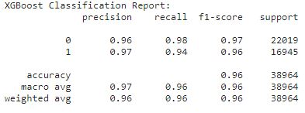
Predictive Modeling
Models | XGBoost | LightGBM | Decision Trees | Gradient Boosting | AdaBoost | Random Forest | Logistic Regression | GaussianNB
F1-Score | 0.96 | 0.96 | 0.95 | 0.94 | 0.93 | 0.92 | 0.87 | 0.85

Slide 6
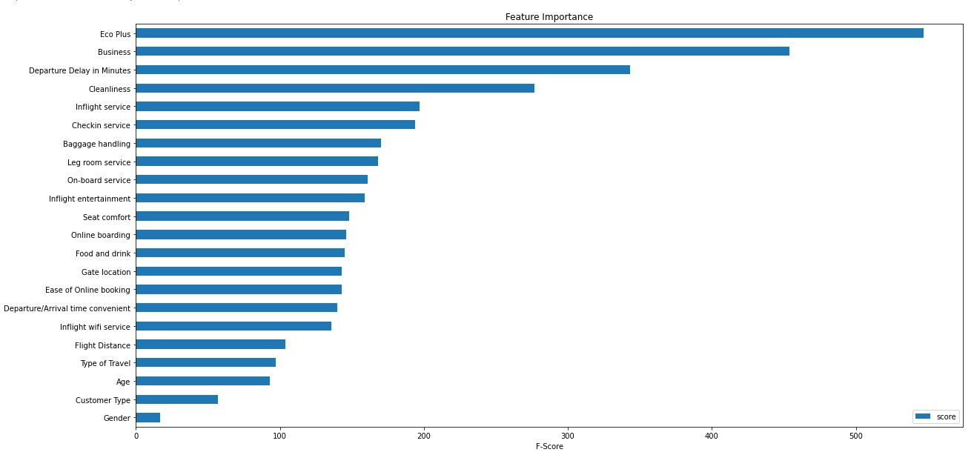
Assessing Feature Importance
Cabin services
Preflight
Flight

Slide 7
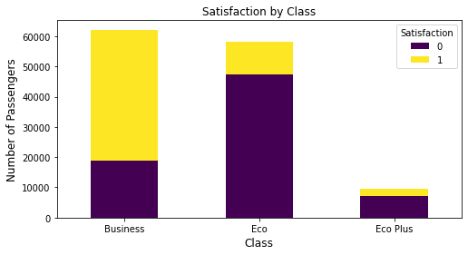
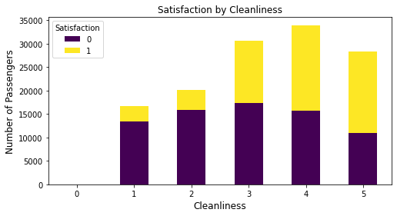
Classy and Clean
The Features of Class and Cleanliness have a significant influence on our target
satisfied=1
non-satisfied=0

Slide 8
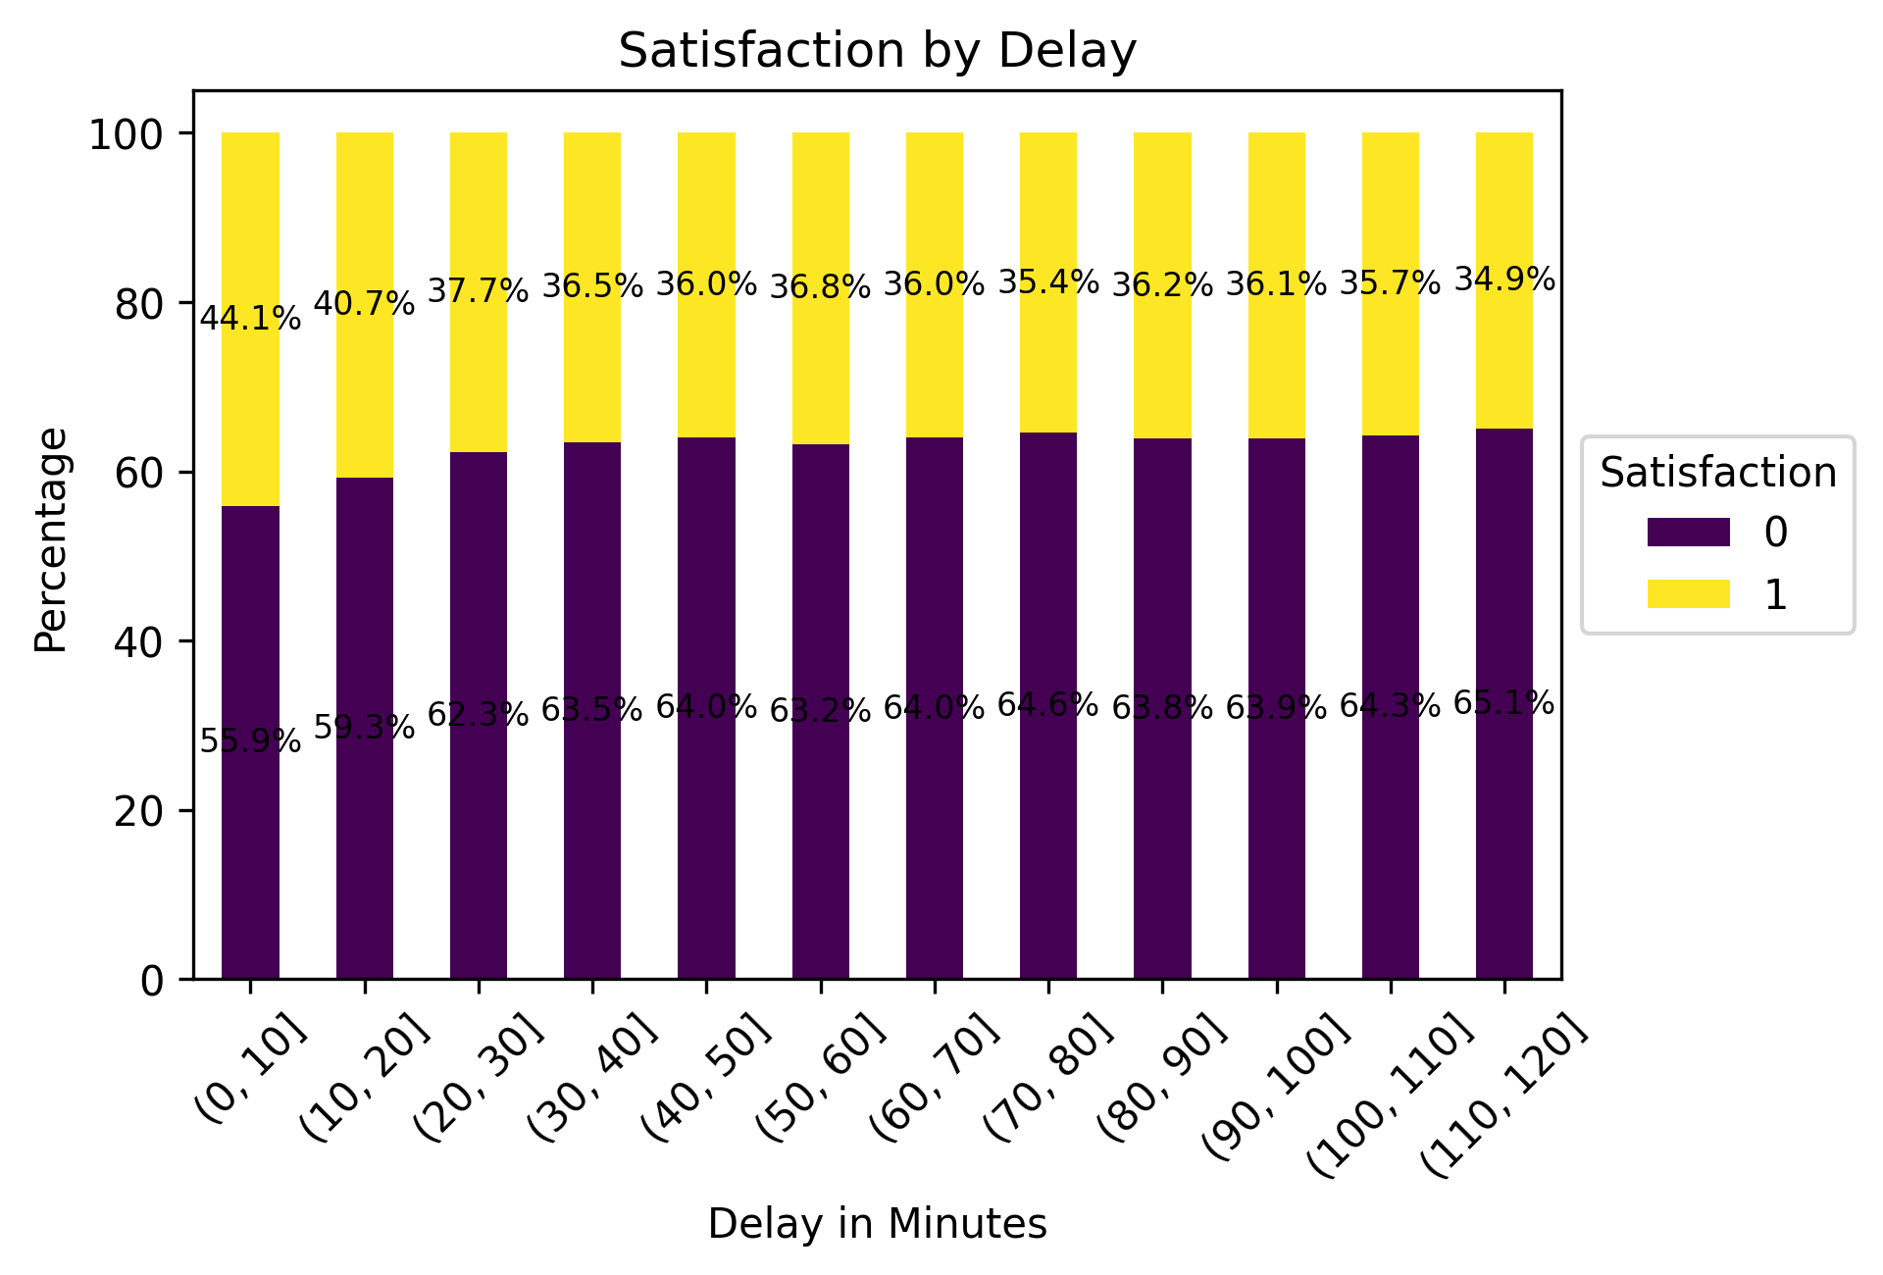
Delay
After 30 minutes of delay there is no big difference in the result
satisfied=1
non-satisfied=0

Slide 9
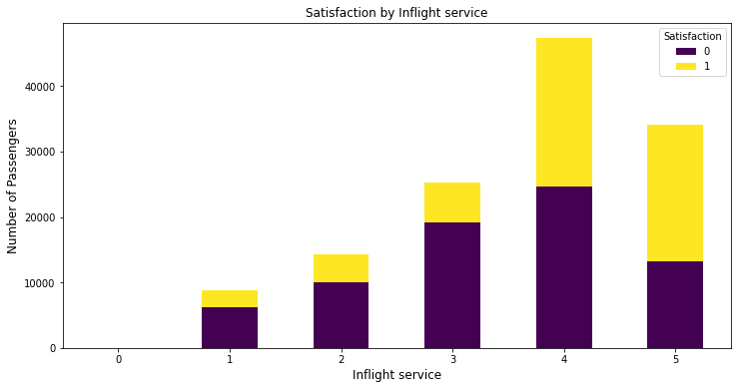
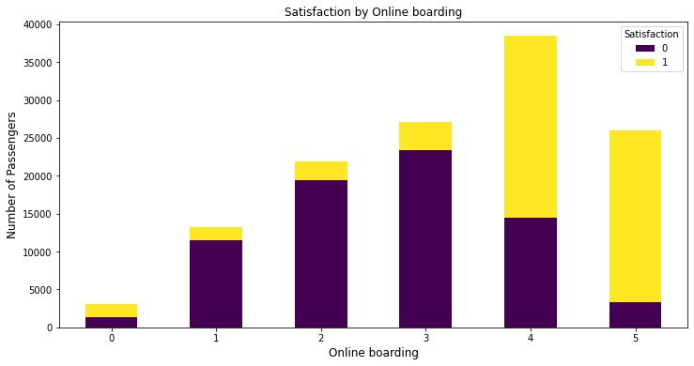
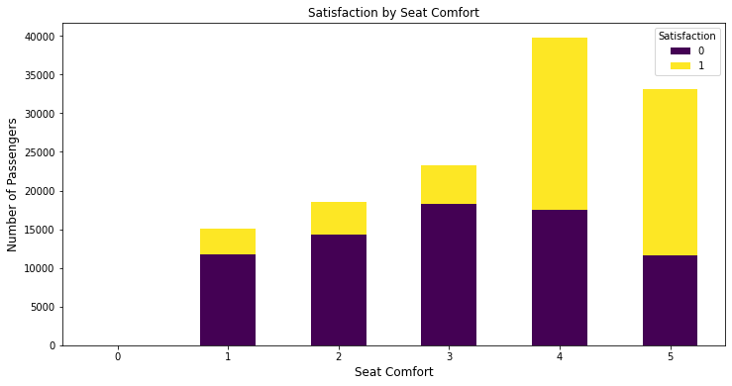
More Data Insights
The Features of Inflight service, Online boarding and Seat Comfort have a significant influence on our target

Slide 10
Insights and Recommendations
Improve Economy Plus Seat Offering:
Improve comfort of existing seats(additional amenities,adjustable headrest)
Enhance On-Time Performance:
optimizing flight schedules
proactive communication with passengers
Prioritize Cleanliness Standards:
Strengthen the cleanliness protocols
Regularly assess and maintain the cleanliness of aircraft cabins, lavatories, and common areas
Monitor and Benchmark Performance:
Continuously monitor passenger satisfaction scores
compare them against industry benchmarks

Slide 11
Summary and Future Directions
Prioritize passenger satisfaction for the success and growth of the airline company.
These actions aim to address the identified factors that strongly influence passenger satisfaction.
Rewarding Loyal Customers:
We propose a loyalty program with mileage rewards
Upgrades from economy plus to business class
Continuous Improvement:
identify emerging trends
Personalization and Tailored Services:
offer personalized and tailored services based on passenger analytics
Collaborative Partnerships:
collaborative partnerships with industry stakeholders
shared best practices and mutually beneficial initiatives

